Slide 1

Verifiable Computation for Embedded Blockchains

Slide 2
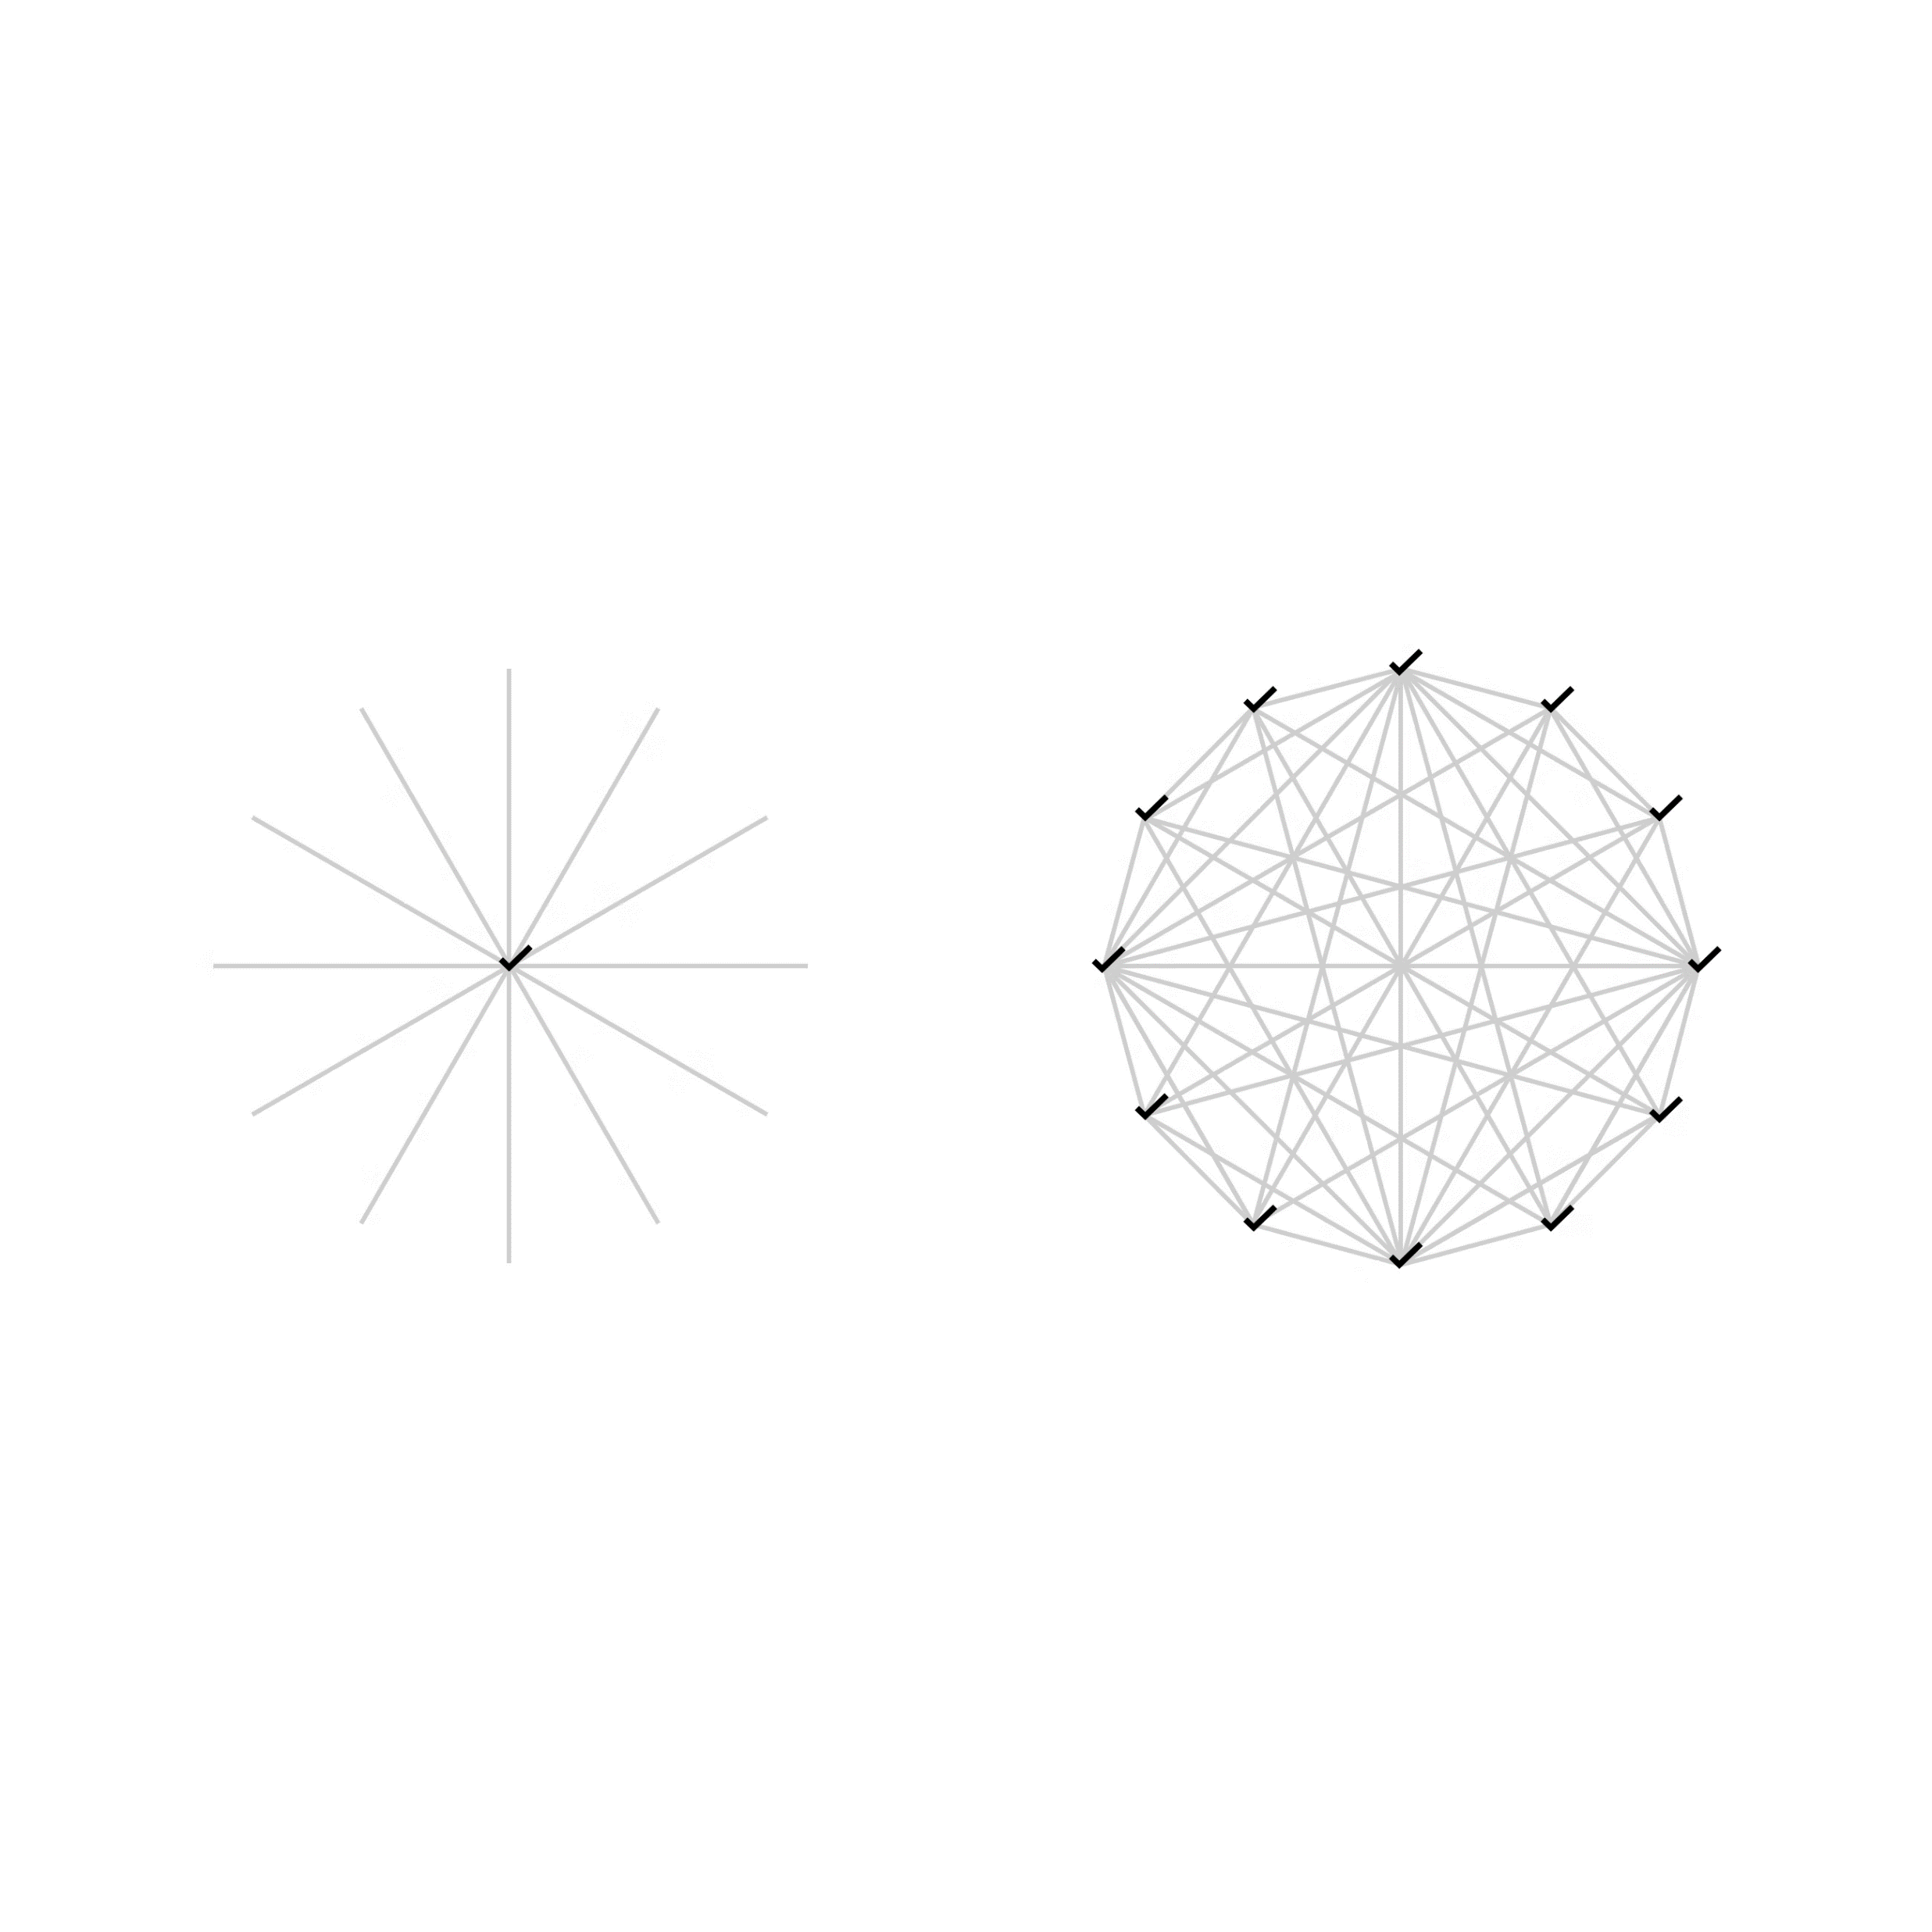
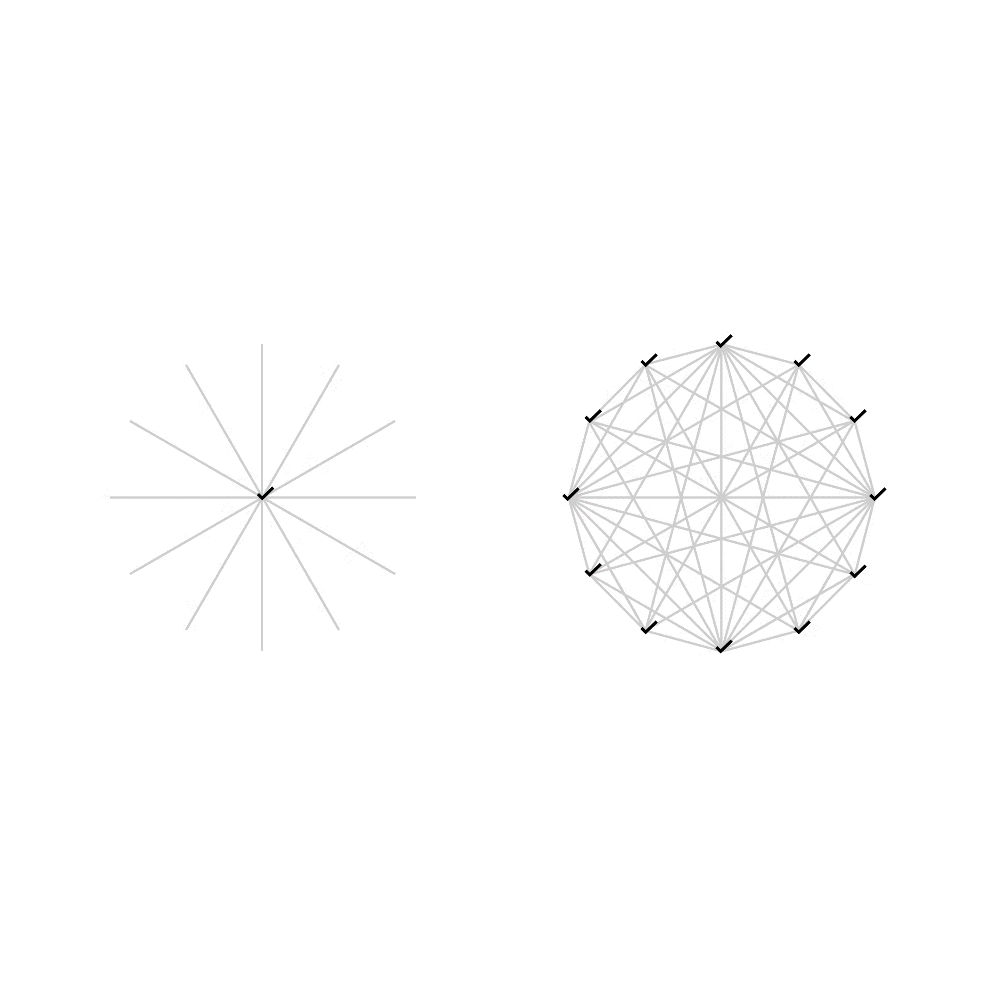

Introduction
Blockchain
Trustless and tamper-proof agreement between all nodes

Slide 3

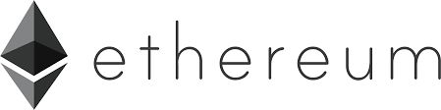
Scalability Solutions: Rollups
EVM is Turing complete
Zero-Knowledge Rollups
Optimistic Rollups
Rely on zero-knowledge proofs:
Proof of valid transaction batch
Hard to compute, fast to verify
Faster finality: verified on chain
Rely on fraud proofs:
Transactions assumed valid
Can claim against it
Chain can be reverted
Under development
Security concerns
Congested
Slow
Expensive
L1 = Security & Consensus

Slide 4

Zero-Knowledge Proofs
Properties:
Zero-Knowledge, Completeness, Soundness
Proof of valid state transition
ZK Rollup: smart contract acts as verifier
 | zk-SNARK | zk-STARK | Bulletproofs
Proving | Quasilinear | Quasilinear | Linear
Verifying | Constant | Polylogarithmic | Linear
Proof size | Constant | Polylogarithmic | Logarithmic
Trusted setup | Yes | No | No
Quantum secure | No | Yes | No
- Validity: proof of computation
- Validium: proof of computation and proof of knowledge

Slide 5
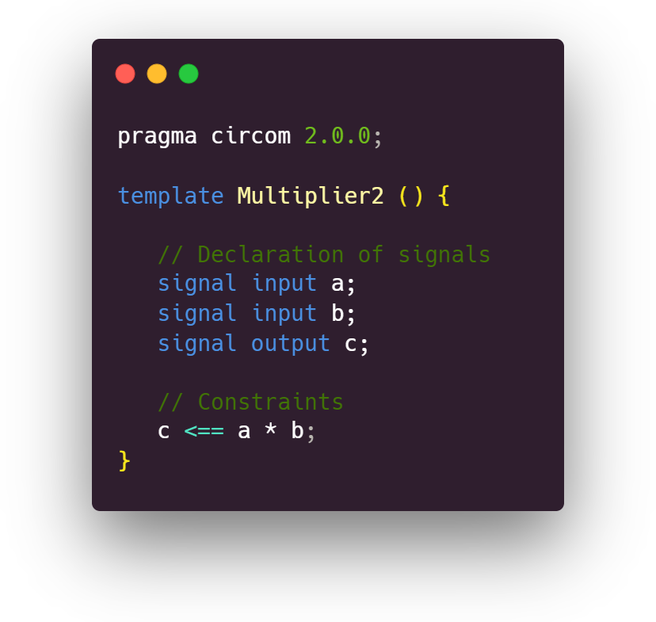
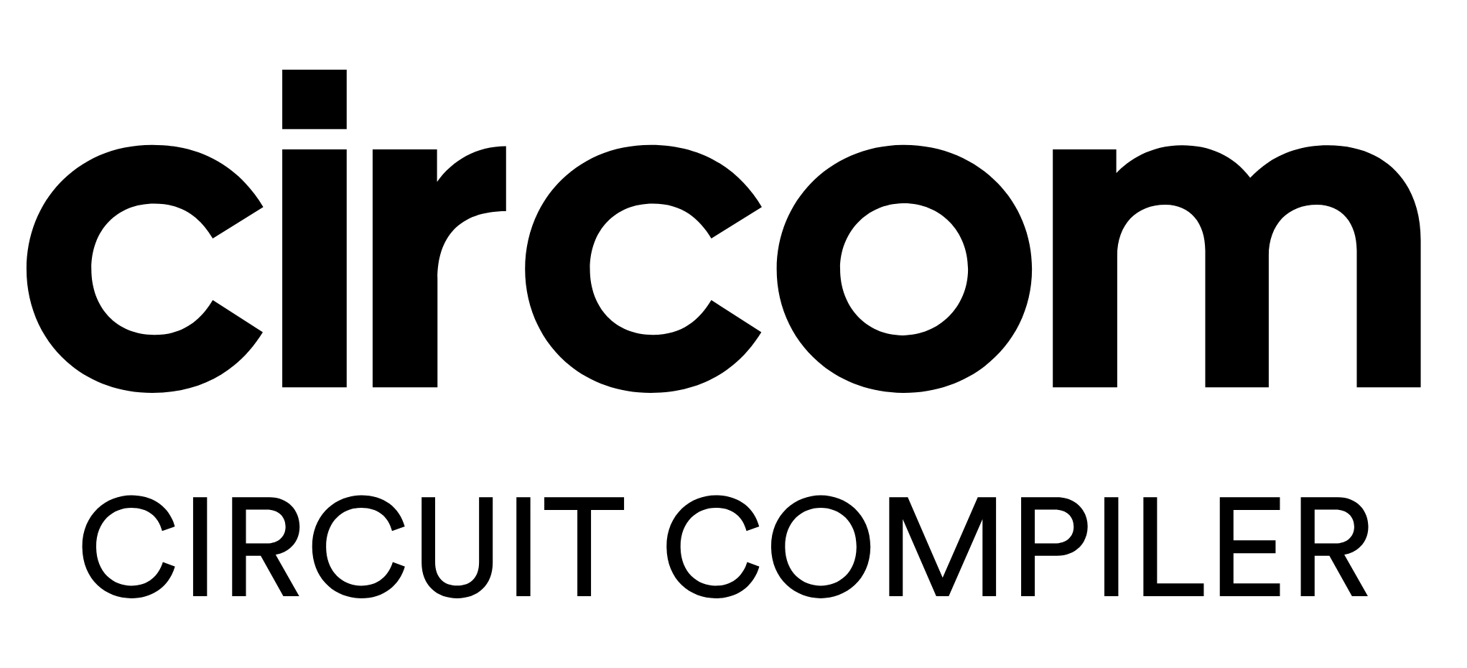
Generating SNARK Proofs
Input
Witness
Trusted
setup

Slide 6
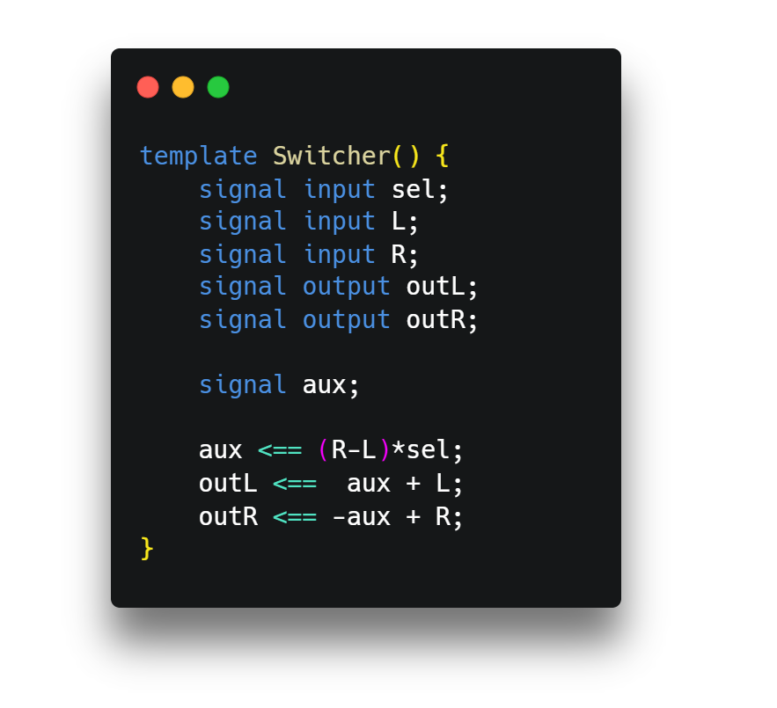
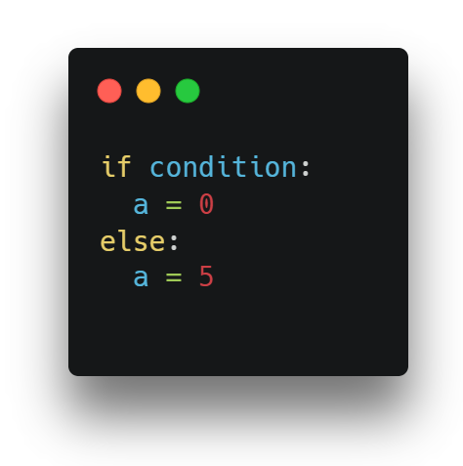
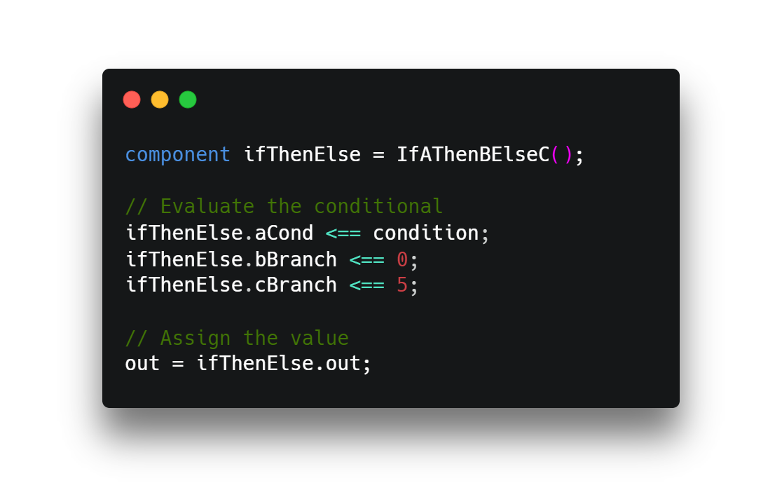
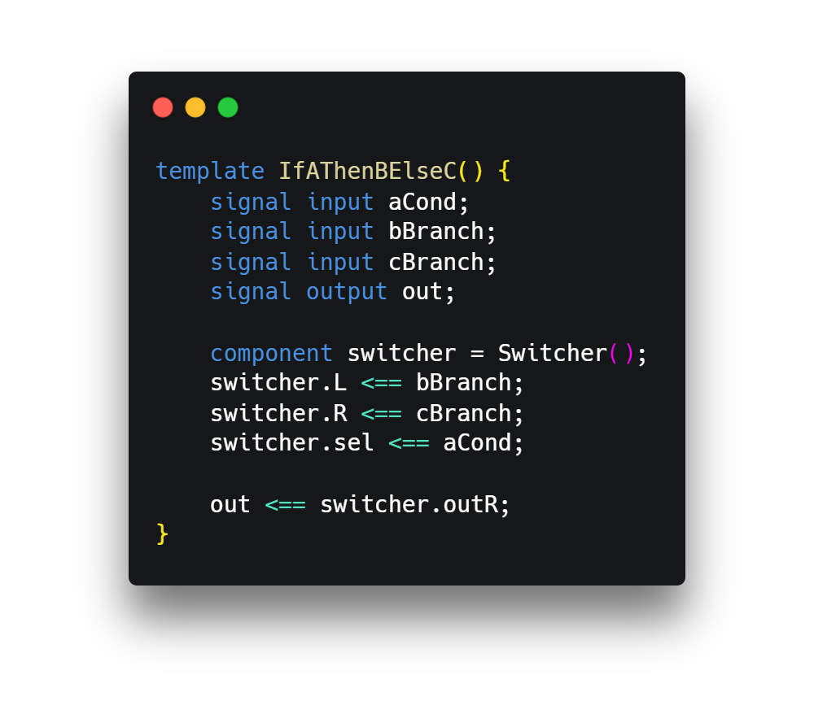
The circom Language

Slide 7
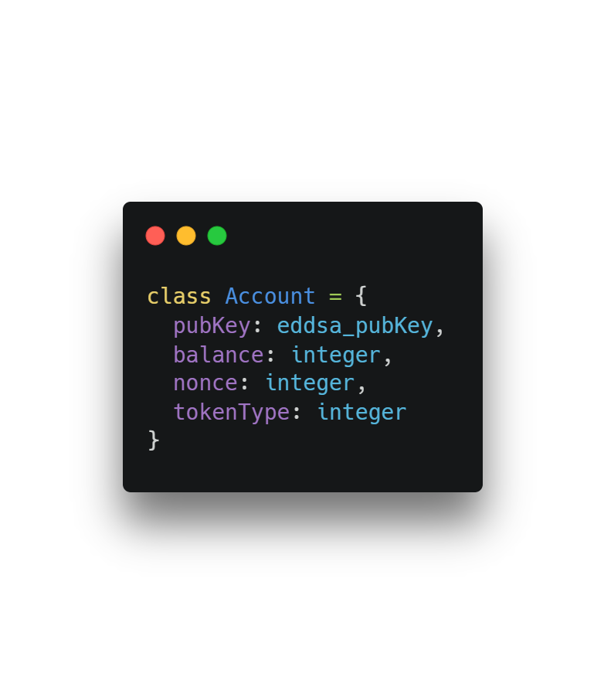
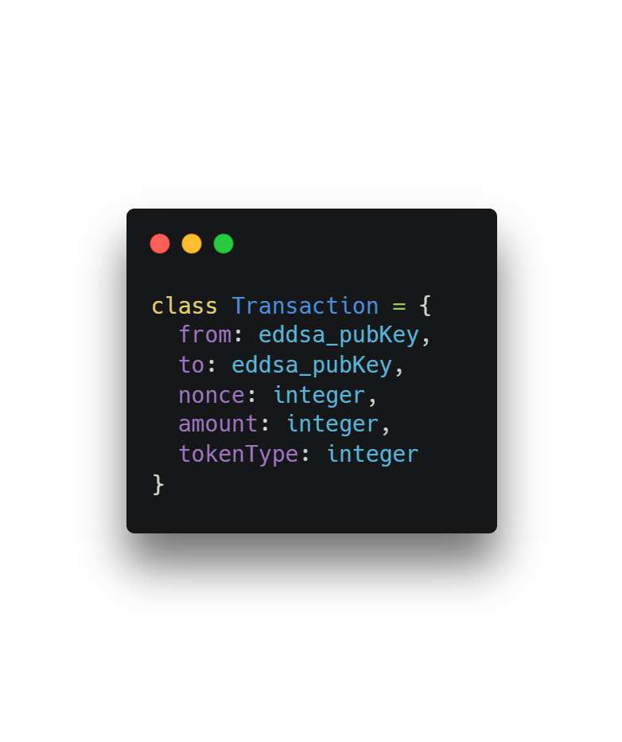
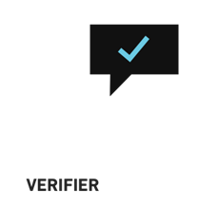
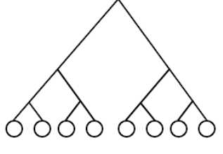
ZK Rollup Prototype
updates currentRoot
SNARK Proof
Valid state
transition
L2 USERS
==
OPERATOR
==
L1 SMART CONTRACT
oldRoot
txRoot
newRoot

Slide 8
Verifying Multiple Transactions
currentRoot
intermediateRoot
newRoot
for loop
txRoot
Sender exists
Supports tokenType
They signed tx
balance > amount
Debit amount
Receiver exists
Supports tokenType
Credit amount

Slide 9
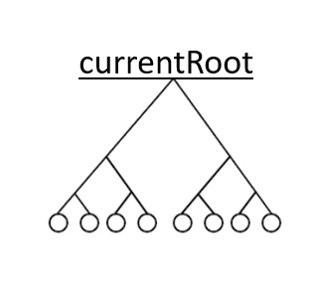

L2 Withdrawal Mechanism
burns the amount to withdraw
step one
USER/
PROVER
USER⠀
ZERO_ADDRESS
balance = 0
step two
SNARK Proof
specified address
tx inclusion &
ownership
==
L1 SMART CONTRACT
Funds on L1

Slide 10
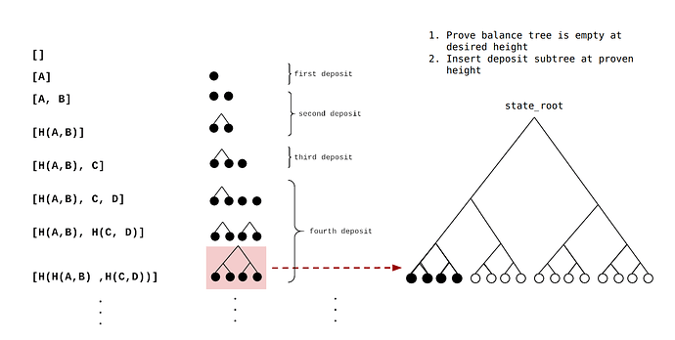
Building the Smart Contract: Handling Deposits
L2 USERS
OPERATOR
pendingDeposits
processDeposits
oldRoot
newRoot
adding deposit subtree

Slide 11
Building the Smart Contract
registerToken
approveToken
deposit
processDeposits
withdraw
updateState
OPERATOR
L2 USERS
Rollup Contract
L2 withdrawal in txRoot
txHash gets voided
SNARK proof:
valid state transition
No knowledge on the state of the accounts
We depend on an honest operator
ownership, signature:
hash(recipient, nonce)
updates currentRoot
stores the txRoot

Slide 12


Validity-Style ZK Rollup: Data Availability
Verify valid state transition
What is the state?
OPERATOR
L1 SMART CONTRACT
Cannot reconstruct the L2 chain
Rely on operator for data
DoS: not including transactions
state lost → cannot reconstruct chain
Solution: post data on-chain
Minimum data possible
to reconstruct the chain
Lower cost by using calldata
not on-chain, available to nodes

Slide 13
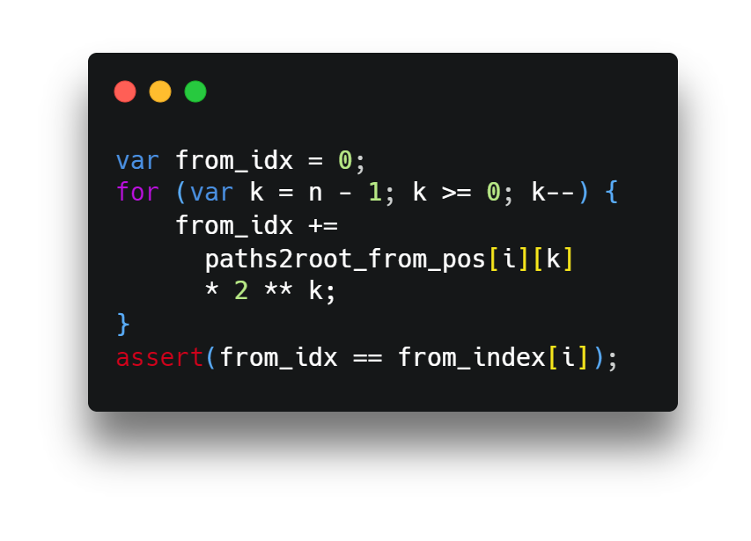
Achieving Full Data Availability
processDeposits
updateState
→ Include from_index and to_index in circuits
Need to prove they are valid!
0
1
0
1
index = 5
Process on-chain → know initial state of every account
tree branches and binary positions already provided!
Provide:
from_index
to_index
amount

Slide 14



Reference: L1 Transactions
ALICE
5 BANAN
BOB
Nonce | ~3
Gas amount | ~8
Gas price | 3
To | 20
Value | ~9
Signature | ~66
From | 0 (from sig)
To | 1-4, using index
Value | 4, sci notation
From | 1-4, using index
L1
18.67x
COMPRESSION
L2
Rest is in the SNARK proof!
Total: ~112 bytes
Total: 6 bytes

Slide 15
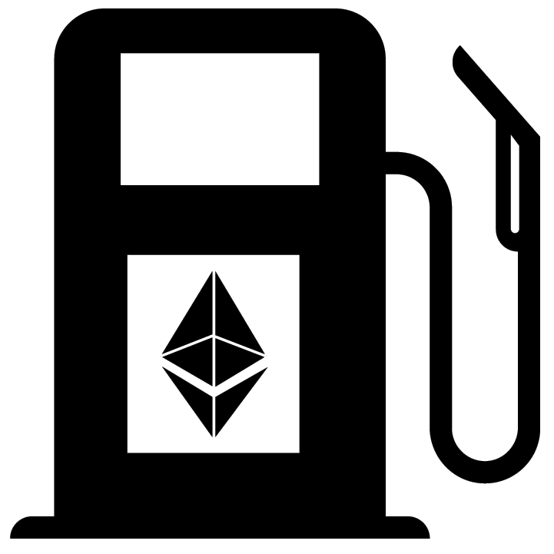
Detour: Ethereum and Gas Fees
Gas represents computational effort,
paid as a fee for every transaction
Gas amount: deterministic, depends on tx
ETH transfer: 21,000 gas
Gas price: supply and demand
measured in gwei = 10⁻⁹ ETH
Block size:
Target: 15M gas
Max: 30M gas

Slide 16
Rollup Benchmarking: Validity vs. Validium
Implemented solution:
16 txs per batch, result of updateState calls
Action | Gas / Price | Max / Avg tx per block | Max / Avg TPS
ETH transfer | 21,000 / $1 | 1430 / 715 | 95 / 48
ERC-20 transfer | 50k – 100k / $2.4 - $4.8 | 300 – 600 / 150 – 300 | 20 – 40 / 10 – 20
 | Gas / Price | Max / Avg tx per block | Max / Avg TPS
Validity-style | ~740,000 / $35.52 | 648 / 324 | 43 / 21
Validium-style | ~310,000 / $14.88 | 1,548 / 774 | 103 / 50
 | Gas / Price | Max / Avg tx per block | Max / Avg TPS
Validity-style | ~700,000 / $33.6 | 87,770 / 43,886 | 5,851 / 2,923
Validium-style | ~310,000 / $14.88 | 198,193 / 99,097 | 13,212 / 6,606
2048 tx / batch
posting, but not verifying data
60x
140x
*prices for $1200/ETH, 40 gwei
**assuming 15 s block time that is filled with the transaction to benchmark

Slide 17
Proving Schemes: groth16 vs. PLONK
Benchmarking
groth16
PLONK
SNARK proving schemes
Needs a second phase for trusted setup
circuit specific
Needs trusted setup, but not specific
can be used to scale general computation
verify groth16 proof: ~230,000 gas
Verify PLONK proof: ~290,000 gas
 | Gas / Price | Max / Avg tx per block | Max / Avg TPS
Validity-style | ~700,000 / $33.6 | 87,770 / 43,886 | 5,851 / 2,923
Validium-style | ~310,000 / $14.88 | 198,193 / 99,097 | 13,212 / 6,606
 | Gas / Price | Max / Avg tx per block | Max / Avg TPS
Validity-style | ~760,000 / $36.5 | 80,842 / 40,421 | 5,389 / 2,694
Validium-style | ~370,000 / $17.76 | 166,054 / 83,027 | 11,070 / 5,535
withdraw transaction: ~630,000 gas / $30.24
withdraw transaction: ~690,000 gas / $33.12

Slide 18


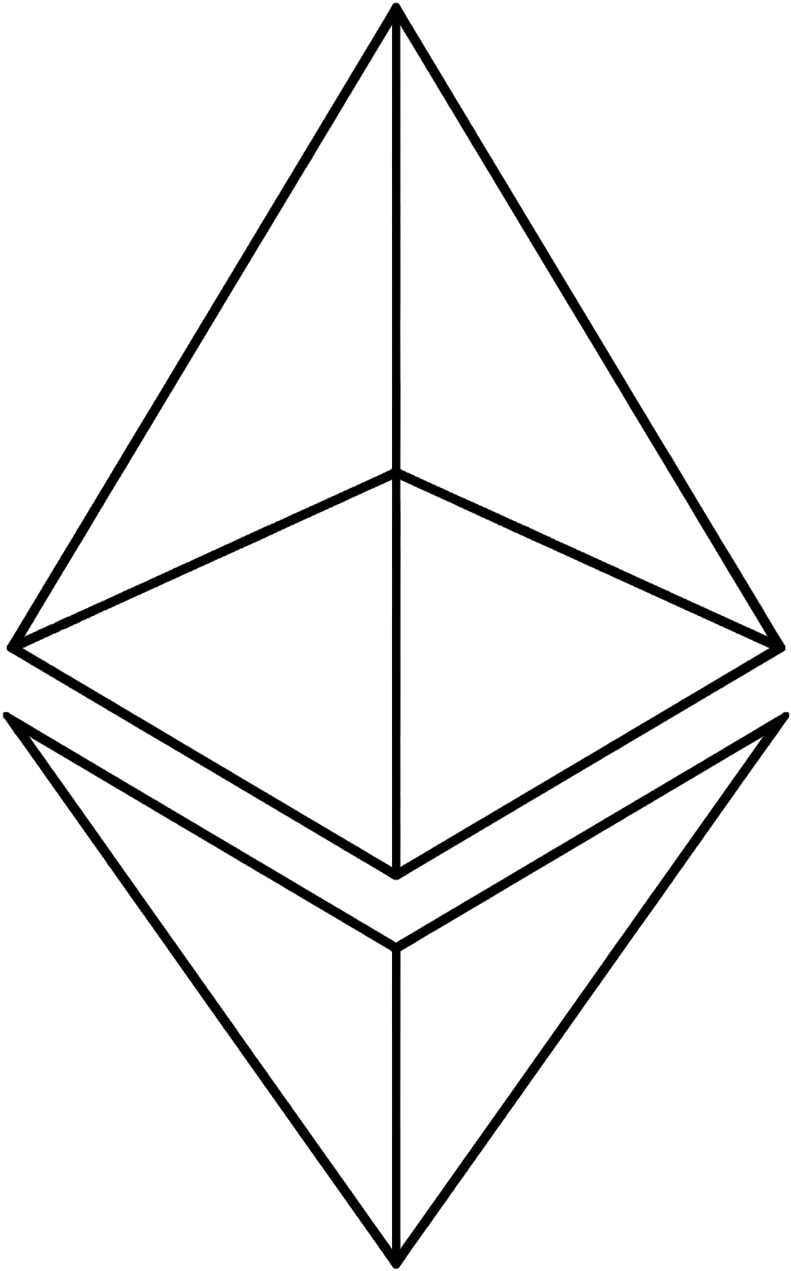
Improvements to Study: Current Implementation
Gas savings
Verifying data
availability
Support for multiple
tokens
Verifying general
computation
Client software –
drones
Big computation!
Decentralize coordinator
Fee mechanism

Slide 19

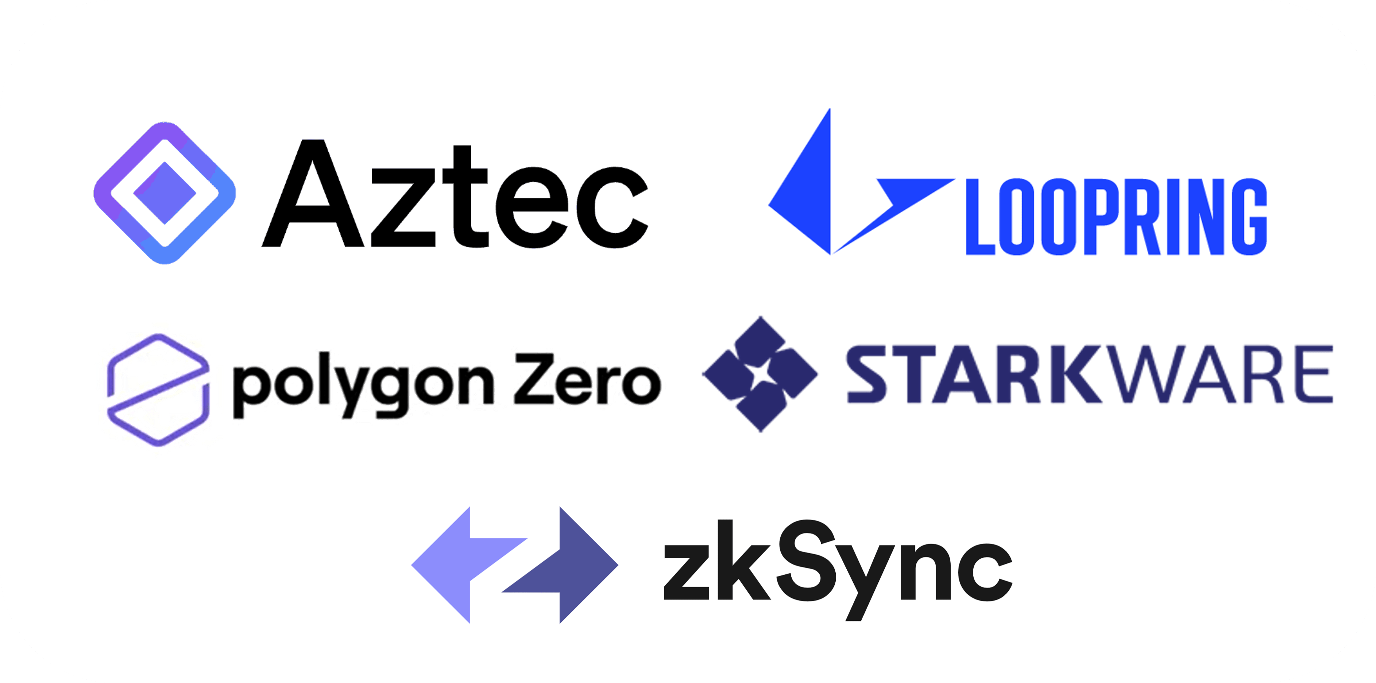
Solutions to Study
STARKs
More efficient circuits
Better zero-knowledge schemes
SEPARATION
Parallel
rollups
Readapting existing implementations

Slide 20

Conclusions
Full security guarantees
~20 TPS
Potential application
>>20 TPS

Slide 21
Conclusions
Scaling solution: zero-knowledge rollups
18.67x COMPRESSION
60x – 140x TPS
Verifying data
availability
Verifying general
computation
Embedding the
solution

